Slide 1

Rex Jones II, CSTE, TMap
BUILDING BLOCKS
FOR
SELENIUM

Slide 2








Programming Languages

Slide 3
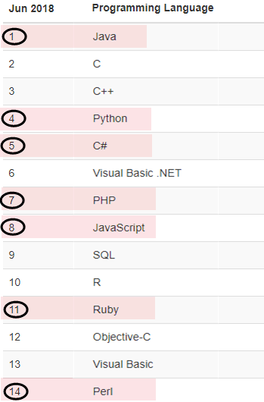
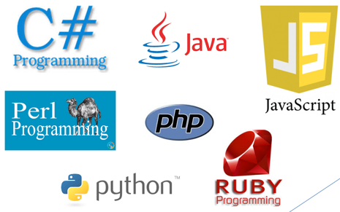
TIOBE Popular Programming Languages

Slide 4




Java Test Frameworks
xUnit Family

Slide 5
Selenium Components
Selenium Components
Selenium IDE
Selenium
Remote Control (RC)
Selenium
WebDriver
Selenium
Grid

Slide 6
Tutorial Plan
Java
Selenium WebDriver
TestNG
Questions, Answers, & Practice

Slide 7
Tutorial Plan
Java
Selenium WebDriver
TestNG
Questions, Answers, & Practice

Slide 8
Data Types
Data Types
Primitive
(Non-Object)
Class
(Object)
Notes:
Explain that Primitive Data Types are called many names then state the other names

Slide 9
Non Object & Object Data Types
Non Object
Object
int
double
boolean
String
WebDriver
WebElement

Slide 10
Tutorial Plan
Java
Selenium WebDriver
TestNG
Questions, Answers, & Practice

Slide 11
WebDriver / WebElement
WebDriver
controls the web browser
implements classes such as ChromeDriver, FirefoxDriver, and InternetExplorerDriver
contain methods such as get and findElement
WebElement
represents an element on a web page
contain methods such as click, sendKeys, and getText

Slide 12
Find WebElements
Syntax
WebDriver driver = new ChromeDriver ();
WebElement element = driver.findElement(By.locator(“value”));
Argument | Description
WebDriver | Class controlling the web browser
driver | Name of the object representing WebDriver
WebElement | Class representing an element on the web page
element | Name of the object representing WebElement
findElement | Returns a WebElement
By | Finds the element by a locator type
locator | Locates a WebElement
value | Value for locating an element based on the locator

Slide 13
WebDriver Element Locators C# and Java

Slide 14
Questions, Answers, & Practice
How many Data Types comes with Java?
What is a template of a Class?
Name the 8 Selenium WebDriver locators:

Slide 15
Questions, Answers, & Practice
How many Data Types comes with Java? There are 2 Java Data Types called Non-Object and Object. Sometimes Non-Object is called Primitive while Object is called Class.
What is a template of a Class? An object is a template of a Class
Name the 8 Selenium WebDriver locators:
className cssSelector id linkText | name partialLinkText tagName xpath

Slide 16
Questions, Answers, & Practice
If You Have Time, Watch This Video (Part 1) Building Blocks For Selenium At Least One More Time
Execute The Same Test Script From Video
Create A Test Script To Save Your Registration For Demo Web Shop Using Different Locators

Slide 17
Tutorial Plan
Java
Selenium WebDriver
TestNG
Questions, Answers, & Practice

Slide 18
Annotations
@BeforeTest – run its Java method 1 time before the first test method
@Test – set its Java method as a test method
@AfterTest – run its Java method 1 time after the last test method

Slide 19
Assertions
assertEquals – verify actual and expected values are equal
assertTrue – verify a condition is true

Slide 20
Tutorial Plan
Java
Selenium WebDriver
TestNG
Questions, Answers, & Practice

Slide 21
Questions, Answers, & Practice
Is it wrong to add multiple tasks in 1 method?
Which annotation sets its Java method as a test method?
What is the purpose of Assertions?

Slide 22
Questions, Answers, & Practice
Is it wrong to add multiple tasks in 1 method? No, it is not wrong but it is a bad programming standard to add more than 1 task in a method.
Which annotation sets its Java method as a test method? @Test sets its Java method as a test method
What is the purpose of Assertions? Assertions verify if a test Pass or Fail

Slide 23
Questions, Answers, & Practice
If You Have Time, Watch This Video (Part 2) Building Blocks For Selenium At Least One More Time
Execute The Same Test Script From Video
Create A Test Script To Verify Demo Web Shop Email And Logout

Slide 24
Suggested Books
Java
Java: A Beginner’s Guide by Herbert Schildt
Absolute Beginner (Part 1) Java 4 Selenium WebDriver by Rex Jones II, CSTE, TMap
(Part 2) Java 4 Selenium WebDriver by Rex Jones II, CSTE, TMap
Selenium WebDriver
(Part 1) Selenium WebDriver For Functional Automation Testing by Rex Jones II, CSTE, TMap
Mastering Selenium WebDriver by Mark Collin
TestNG
Getting Started With TestNG by Rex Jones II, CSTE, TMap
Next Generation Java Testing by Cedric Beust
TestNG Beginner’s Guide by Varun Menon
Books By Rex Jones II - http://tinyurl.com/Rex-Allen-Jones-Books

